Slide 1
Chapter 1 Basic Concepts
簡廷因 2020.09.15

Slide 2
Chapter 1 Basic Concepts
1.1 Overview: System Life Cycle
1.2 Pointers and Dynamic Memory Allocation (option)
1.3 Algorithm Specification
1.4 Data Abstraction
1.5 Performance Analysis
1.6 Performance Measurement

Slide 3
Overview: System Life Cycle

Slide 4
System life cycle
Good programmers regard large-scale computer programs as systems that contain many complex interacting parts.
As systems, these programs undergo a development process called the system life cycle.

Slide 5
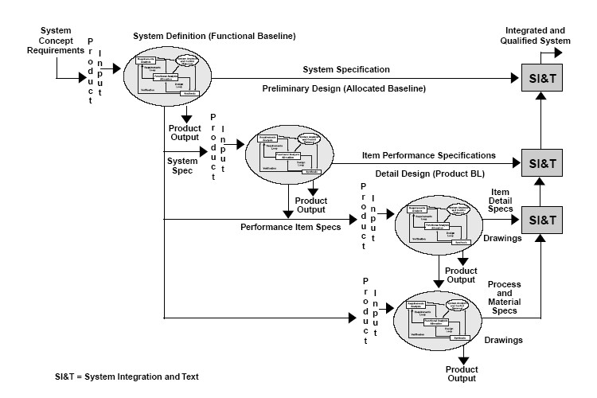
How to create programs
We consider this cycle as consisting of five phases.
Requirements (Leader / PM)
Specification
Rigorous input & output descriptions
Analysis: bottom-up vs. top-down
Design: data objects and operations
E.g data object: students, teachers
E.g operation: insert, delete
Refinement and Coding
Choose representation for the data objects
Write program
Verification (QA)
Correctness proofs
Program Proving
Testing
Error removal
Debugging
https://en.wikipedia.org/wiki/Functional_specification#/media/File:Specification_and_Levels_of_Development.jpg

Slide 6

bottom-up vs. top-down
bottom-up
Emphasis on the coding fine points
Loosely connected
Error-ridden segments
top-down
Begin with the purpose
https://kknews.cc/tech/k38z9bv.html

Slide 7
Algorithm Specification

Slide 8
Algorithm Specification
1.3.1 Introduction
An algorithm is a finite set of instructions that accomplishes a particular task.
Criteria
input: zero or more quantities that are externally supplied
output: at least one quantity is produced
definiteness: clear and unambiguous
finiteness: terminate after a finite number of steps
effectiveness: instruction is basic enough to be carried out
A program does not have to satisfy the finiteness criteria.
E.g : An operating system continues in a wait loop
輸入>=0
輸出>=1
指令明確
程式必須終止
指令可被實現

Slide 9
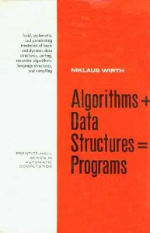
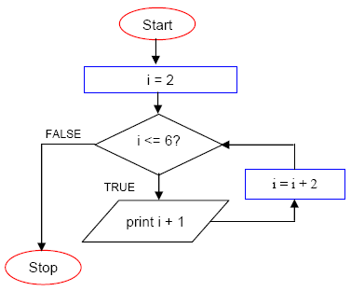
Algorithm Specification
Representation
A natural language, like English or Chinese.
A graphic, like flowcharts.
A computer language, like C.
Pseudo-code
Algorithms + Data structures = Programs
https://en.wikipedia.org/wiki/Algorithms_%2B_Data_Structures_%3D_Programs#/media/File:Algorithms_+_Data_Structures.jpg
Niklaus Wirth ( Turing Award winner in 1984)
https://stackoverflow.com/questions/879250/how-to-picture-for-loop-in-block-representation-of-algorithm

Slide 10
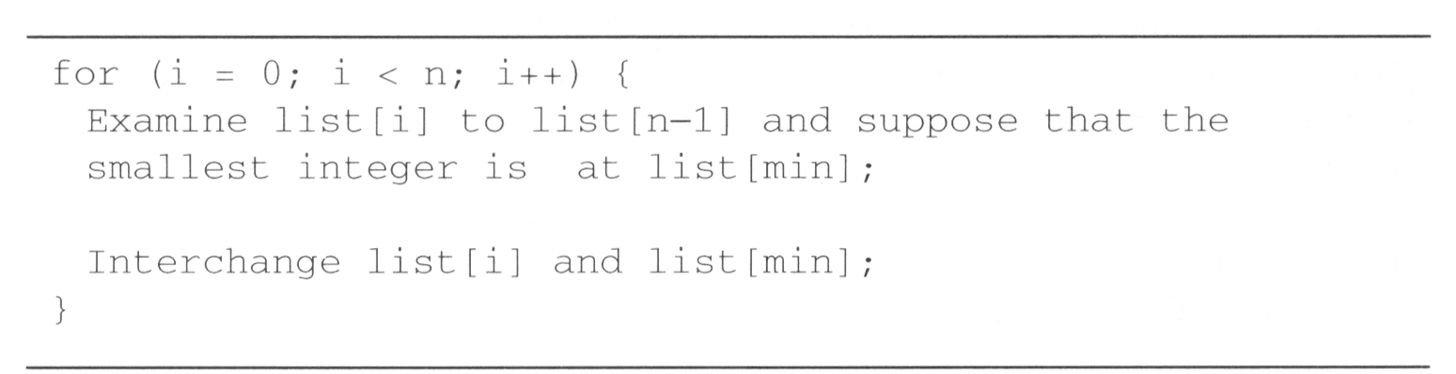
Selection sort (example 1.1)
From those integers that are currently unsorted, find the smallest and place it next in the sorted list.
i [0] [1] [2] [3] [4]
- 30 10 50 40 20
0 10 30 50 40 20
1 10 20 50 40 30
2 10 20 30 40 50
3 10 20 30 40 50
swap

Slide 11
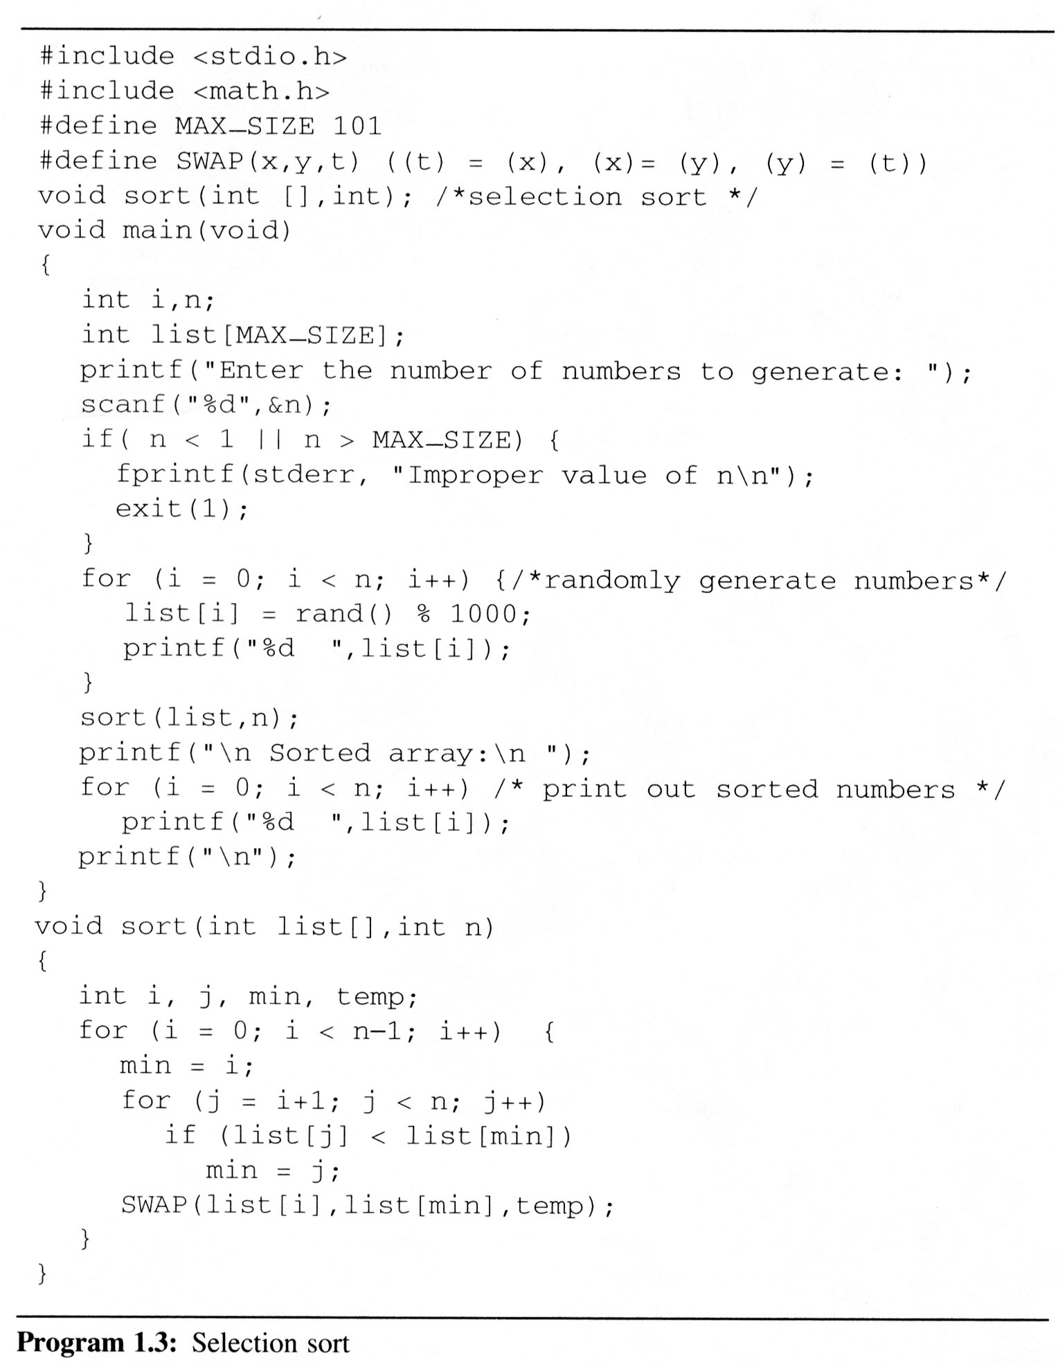
Selection sort

Slide 12
Binary search (example 1.2)
A sorted and stored in the array list
while (there are more integers to check) {
middle = (left + right) / 2;
if (searchnum < list[middle])
right = middle - 1;
else if (searchnum == list[middle])
return middle;
else left = middle + 1;
}
[0] [1] [2] [3] [4] [5] [6]
8 14 26 30 43 50 52
left right middle list[middle] : searchnum
0 6 3 30 < 43
4 6 5 50 > 43
4 4 4 43 == 43
0 6 3 30 > 18
0 2 1 14 < 18
2 2 2 26 > 18
2 1 -

Slide 13
Binary search
int binsearch (int list[], int searchnum, int left, int right){
/* search list[0] <= list[1] <= … <= list[n-1] for searchnum.
Return its position if found. Otherwise return -1 */
int middle;
while (left <= right) {
middle = (left + right)/2;
switch ( COMPARE (list[middle], searchnum)){
case -1: left = middle + 1;
break;
case 0 : return middle;
case 1 : right = middle - 1;
}
}
return -1;
}

Slide 14
Algorithm Specification
1.3.2 Recursive algorithms
direct recursion: This perspective ignores the fact that functions can call themselves
indirect recursion: They may call other functions that invoke the calling function again
extremely powerful
frequently allow us to express an otherwise complex process in very clear term

Slide 15
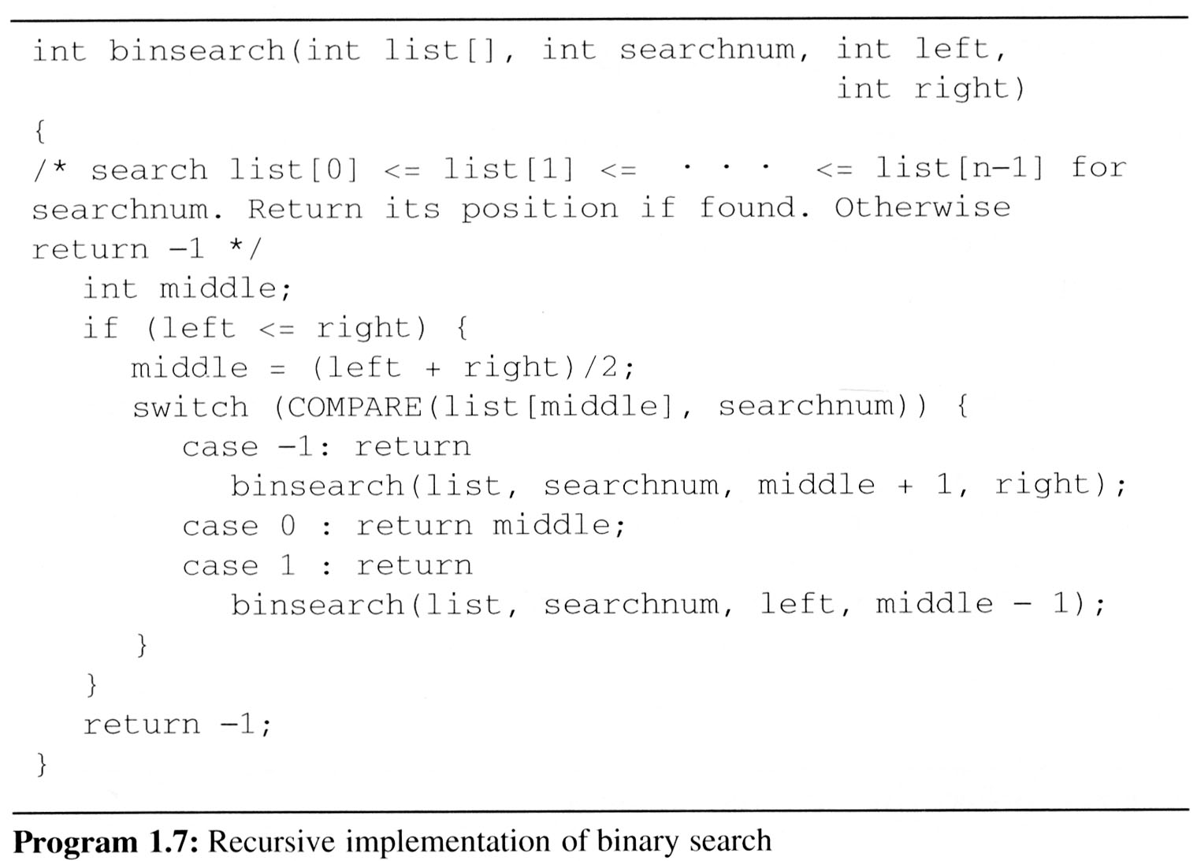
Binary search (example 1.3)

Slide 16
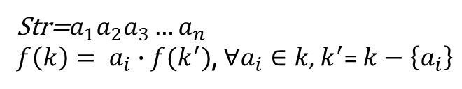
Permutations (example 1.4)
Given a set of n>=1 elements, print out all possible permutations of this set.
For example: the set is {a, b, c}, then the set of permutation is {(a, b, c), (a, c, b), (b, a, c), (b, c, a), (c, a, b), (c, b, a)}
Idea
a followed by all permutations of (b, c)
b followed by all permutations of (a, c)
c followed by all permutations of (a, b)
前面n-1項可被處理，則第n項也可以
Str=$a_{1}a_{2}a_{3}…a_{n}$
$f\left(k\right)= a_{i}∙f(k^{′})$, $∀a_{i}∈k,$ $k^{′}$= $k−\left\{a_{i}\right\}$

Slide 17
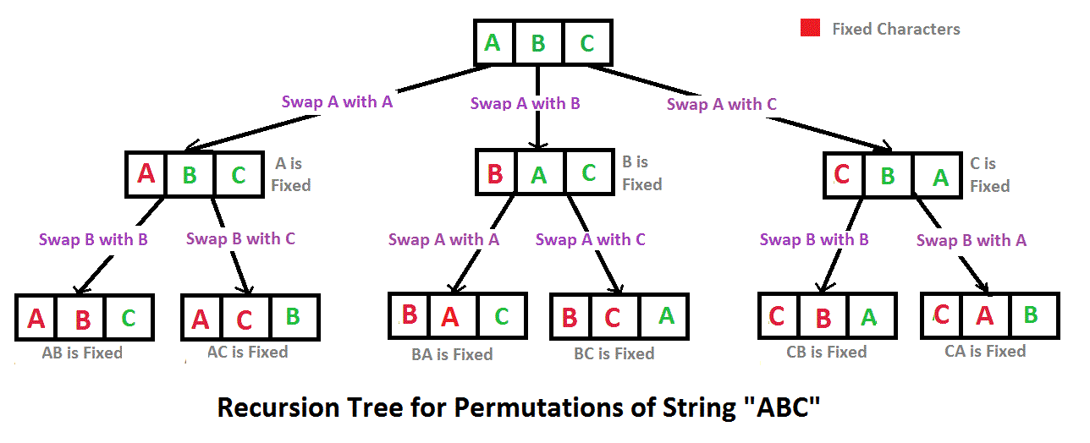
Permutations (example 1.4)
https://www.geeksforgeeks.org/write-a-c-program-to-print-all-permutations-of-a-given-string/

Slide 18
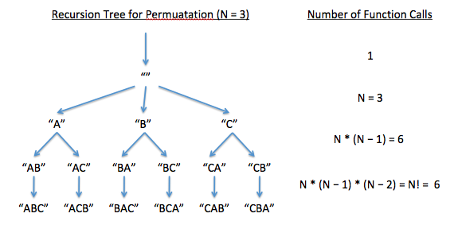
Permutations (example 1.4)

Slide 19
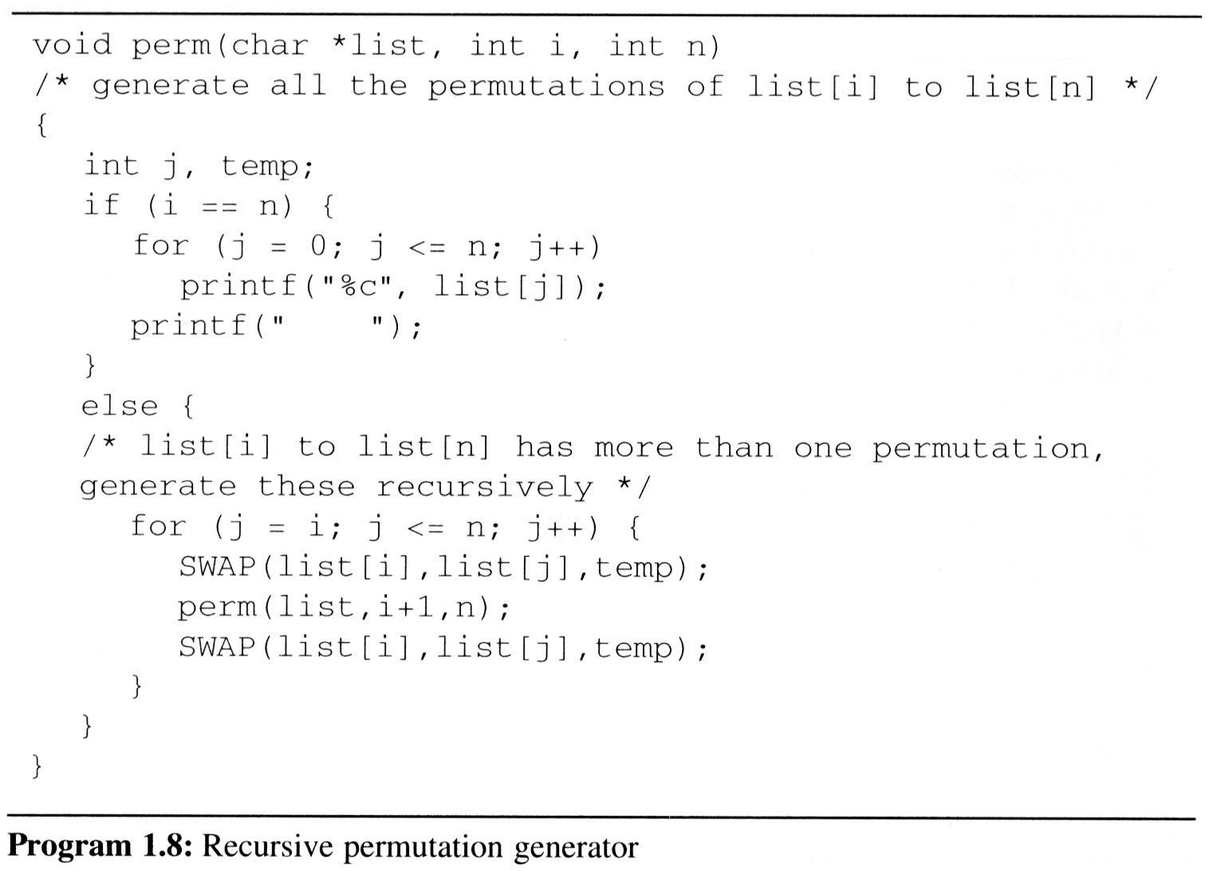
Permutations (example 1.4)
Call Stack:
main
First,
We Permutations the
char *string = “abc” ;
by call perm(string,0,2);
0 is start index
2 is end index
Perm ( string , 0 , 2 )
Print The String
“abc”
Print The String
“acb”
Print The String
“bac”
Print The String
“bca”
Perm ( string , 1 , 2 )
Perm ( string , 2 , 2 )
SWAP ( list[0],list[0], temp)
SWAP ‘a’ ⬄ ‘a’
SWAP ( list[1],list[1], temp)
SWAP ‘b’ ⬄ ‘b’
SWAP ( list[1],list[1], temp)
SWAP ‘b’ ⬄ ‘b’
SWAP ( list[1],list[2], temp)
SWAP ‘b’ ⬄ ‘c’
SWAP ( list[1],list[2], temp)
SWAP ‘b’ ⬄ ‘c’
SWAP ( list[0],list[0], temp)
SWAP ‘a’ ⬄ ‘a’
SWAP ( list[0],list[1], temp)
SWAP ‘a’ ⬄ ‘b’
SWAP ( list[1],list[1], temp)
SWAP ‘b’ ⬄ ‘b’
SWAP ( list[1],list[1], temp)
SWAP ‘b’ ⬄ ‘b’
SWAP ( list[1],list[2], temp)
SWAP ‘a’ ⬄ ‘c’
SWAP ( list[1],list[2], temp)
SWAP ‘a’ ⬄ ‘c’
I=0 J=0 N=2
I=1 J=1 N=2
I=1 J=1 N=2
I=1 J=2 N=2
I=1 J=2 N=2
I=0 J=0 N=2
I=0 J=1 N=2
I=1 J=3 N=2
I=1 J=1 N=2
I=1 J=1 N=2
I=1 J=2 N=2
I=1 J=2 N=2
I=1 J=3 N=2
Call : perm ( list,1, 2)
Call : perm ( list,2, 2)
Call : perm ( list,2, 2)
Call : perm ( list,1, 2)
Call : perm ( list,2, 2)
Call : perm ( list,2, 2)

Slide 20
lv0 perm: i=0, n=2 abc
lv0 SWAP: i=0, j=0 abc
lv1 perm: i=1, n=2 abc
lv1 SWAP: i=1, j=1 abc
lv2 perm: i=2, n=2 abc
print: abc
lv1 SWAP: i=1, j=1 abc
lv1 SWAP: i=1, j=2 abc
lv2 perm: i=2, n=2 acb
print: acb
lv1 SWAP: i=1, j=2 acb
lv0 SWAP: i=0, j=0 abc
lv0 SWAP: i=0, j=1 abc
lv1 perm: i=1, n=2 bac
lv1 SWAP: i=1, j=1 bac
lv2 perm: i=2, n=2 bac
print: bac
lv1 SWAP: i=1, j=1 bac
lv1 SWAP: i=1, j=2 bac
lv2 perm: i=2, n=2 bca
print: bca
lv1 SWAP: i=1, j=2 bca
lv0 SWAP: i=0, j=1 bac
lv0 SWAP: i=0, j=2 abc
lv1 perm: i=1, n=2 cba
lv1 SWAP: i=1, j=1 cba
lv2 perm: i=2, n=2 cba
print: cba
lv1 SWAP: i=1, j=1 cba
lv1 SWAP: i=1, j=2 cba
lv2 perm: i=2, n=2 cab
print: cab
lv1 SWAP: i=1, j=2 cab
lv0 SWAP: i=0, j=2 cba
Permutations (example 1.4)

Slide 21
Data Abstraction

Slide 22
Data Abstraction
Data Type A data type is a collection of objects and a set of operations that act on those objects.
For example, the data type int consists of the objects {0, +1, -1, +2, -2, …, INT_MAX, INT_MIN} and the operations +, -, *, /, and %.
The data types of C
The basic data types: char, int, float and double
The group data types: array and struct
The pointer data type
The user-defined types

Slide 23
Data Abstraction
Abstract Data Type
An abstract data type(ADT) is a data type that is organized in such a way that the specification of the objects and the operations on the objects is separated from the representation of the objects and the implementation of the operations.
We know what is does, but not necessarily how it will do it.
For example:
Ada programming language (package)
C++ programming language (class)
ADTs are often implemented as modules: the module's interface declares procedures that correspond to the ADT operations, sometimes with comments that describe the constraints.

Slide 24
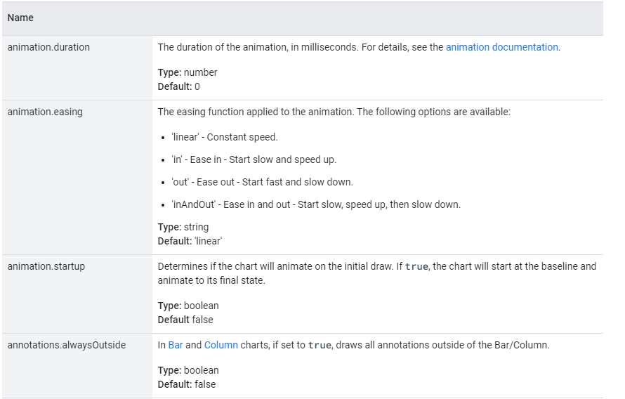
Data Abstraction
Specification vs. Implementation
An ADT is implementation independent
Operation specification
function name
the types of arguments
the type of the results
The functions of a data type can be classify into several categories:
creator / constructor
transformers
observers / reporters
https://developers.google.com/chart/interactive/docs/gallery/barchart#configuration-options

Slide 25
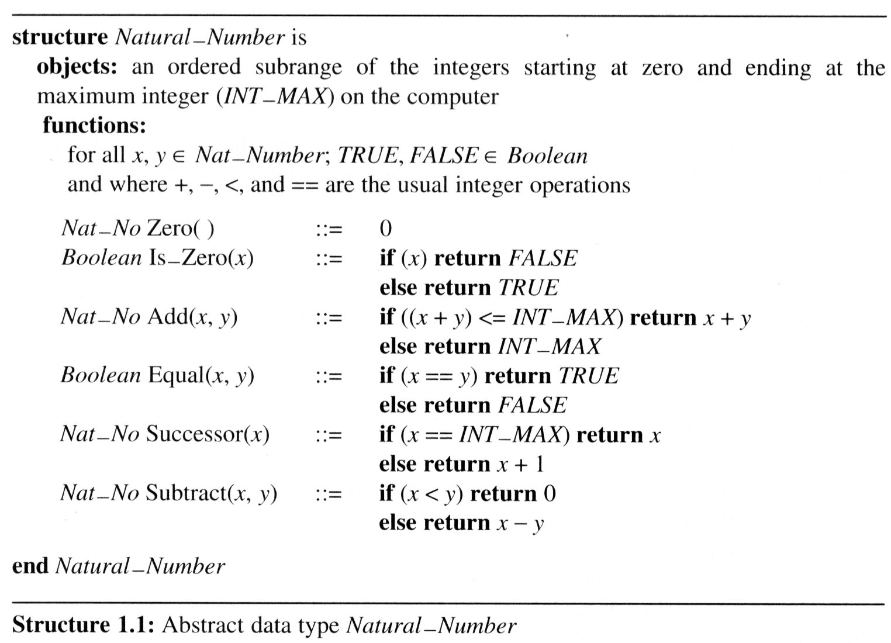
Data Abstraction
Abstract data type Natural_Number
::= is defined as

Slide 26
Performance Analysis

Slide 27
Performance Analysis
Criteria
Is it correct?
Is it readable?
…
Performance Analysis (machine independent)
space complexity: memory space requirement
time complexity: computing time
Performance Measurement (machine dependent)

Slide 28
Performance Analysis
1.5.1 Space Complexity
S(P)=C+S_{P}(I)
Fixed Space Requirements (C) Independent of the characteristics of the inputs and outputs
instruction space
space for simple variables, fixed-size structured variable, constants
Variable Space Requirements (S_{P}(I)) depend on the instance characteristic I
number, size, values of inputs and outputs associated with I
recursive stack space, formal parameters, local variables, return address

Slide 29
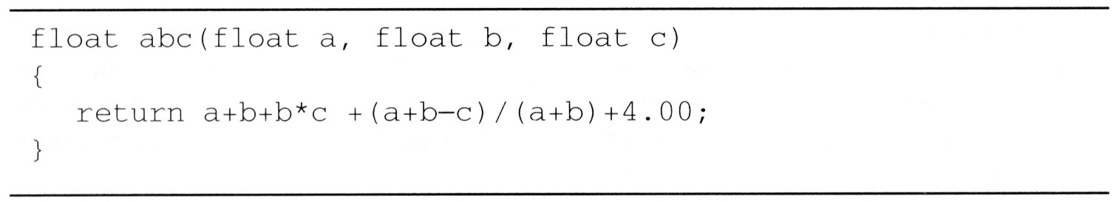
Example 1.6
S_{abc}(I) = 0

Slide 30
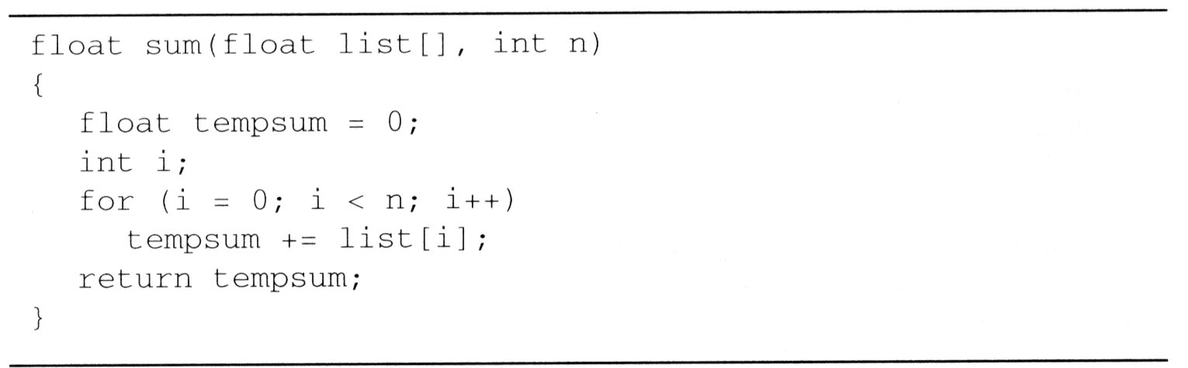
Example 1.7
S_{sum}(I) = 0
C只傳送第一個元素位置，並沒有複製陣列
Recall: pass the address of the first element of the array & pass by value

Slide 31
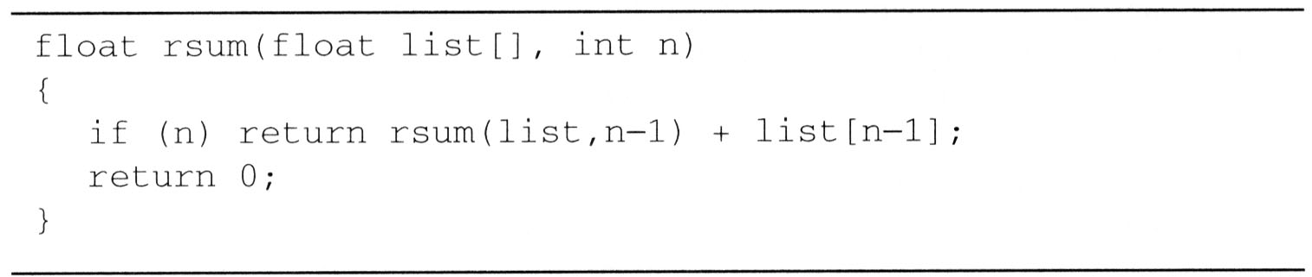
Example 1.8
S_{sum}(I)=S_{sum}(n)=12n

Slide 32
Performance Analysis
1.5.2 Time Complexity
T(P)=C+T_{P}(I)
The time, T(P), taken by a program, P, is the sum of its compile time C and its run (or execution) time, T_{P}(I)
Fixed time requirements
Compile time (C), independent of instance characteristics
Variable time requirements
Run (execution) time T_{P}

Slide 33
Performance Analysis
A program step is a syntactically or semantically meaningful program segment whose execution time is independent of the instance characteristics.
Example (Regard as the same unit machine independent)
abc = a + b + b * c + (a + b - c) / (a + b) + 4.0
abc = a + b + c
Methods to compute the step count
Introduce variable count into programs
Tabular method
Determine the total number of steps contributed by each statement step per execution × frequency
add up the contribution of all statements

Slide 34
Example 1.9
float sum(float list[ ], int n)
{
float tempsum = 0; count++; /* for assignment */
int i;
for (i = 0; i < n; i++) {
count++; /*for the for loop */
tempsum += list[i]; count++; /* for assignment */
}
count++; /* last execution of for */
count++; /* for return */
return tempsum;
}
2n + 3 steps

Slide 35
Example 1.9
float sum(float list[ ], int n)
{
float tempsum = 0;
int i;
for (i = 0; i < n; i++) {
count+=2;
}
count+=3;
return tempsum;
}
2n + 3 steps

Slide 36
Example 1.9
Tabular Method
steps/execution

Slide 37
Example 1.10
float rsum (float list[ ], int n){
count++; /*for if conditional */
if (n) {
count++; /* for return and rsum invocation*/
return rsum (list, n-1) + list[n-1];
}
count++;
return list[0];
}
2n + 2 steps

Slide 38
Example 1.10

Slide 39
Example 1.10
Matrix addition
void add(int a[ ][MAX_SIZE], int b[ ][MAX_SIZE],int c[ ][MAX_SIZE], int row, int cols )
{
int i, j;
for (i = 0; i < rows; i++){
count++; /* for i for loop */
for (j = 0; j < cols; j++) {
count++; /* for j for loop */
c[i][j] = a[i][j] + b[i][j];
count++; /* for assignment statement */
}
count++; /* last time of j for loop */
}
count++; /* last time of i for loop */
}
rows * (2*cols + 2 ) + 1 = 2rows * cols + 2 rows + 1
Suggestion: Interchange the loops when rows >> cols

Slide 40
Example 1.10

Slide 41
Performance Analysis
1.5.3 Asymptotic notation (O, Ω, Θ)

Slide 42

Performance Analysis
Definition: [Big “oh’’] O (upper bound)
f(n) = O(g(n)) iff there exist positive constants c and n₀ such that f(n) ≤ cg(n) for all n, n ≥ n₀.
Definition: [Omega] Ω (lower bound)
f(n) = Ω(g(n)) (read as “f of n is omega of g of n”) iff there exist positive constants c and n₀ such that f(n) ≥ cg(n) for all n, n ≥ n₀.
Definition: [Theta] Θ
f(n) = Θ(g(n)) (read as “f of n is theta of g of n”) iff there exist positive constants c₁, c₂, and n₀ such that c₁g(n) ≤ f(n) ≤ c₂g(n) for all n, n ≥ n₀.
可比原先級距高
可比原先級距低
可想成計算量的成長幅度, 例如：n³會比n²成長幅度快
$$n^{n}>n!>2^{n}>n^{3}>n^{2}>nlogn>n$$

Slide 43
[Big “oh’’] O
Examples
3n+2=O(n) /* 3n+2≤4n for n≥2 */
3n+3=O(n) /* 3n+3≤4n for n≥3 */
100n+6=O(n) /* 100n+6≤101n for n≥10 */
10n²+4n+2=O(n²) /* 10n²+4n+2≤11n² for n≥5 */
6*2^{n}+n²=O(2^{n}) /* 6*2^{n}+n² ≤7*2^{n} for n≥4 */
10n²+4n+2=O(n⁴)
線性成長
平方成長
指數成長

Slide 44
Example
Complexity of c₁n²+c₂n and c₃n
for sufficiently large of value, c₃n is faster than c₁n²+c₂n
for small values of n, either could be faster
c₁=1, c₂=2, c₃=100 --> c₁n²+c₂n ≤ c₃n for n ≤ 98
c₁=1, c₂=2, c₃=1000 --> c₁n²+c₂n ≤ c₃n for n ≤ 998
break even point
no matter what the values of c1, c2, and c3, the n beyond which c₃n is always faster than c₁n²+c₂n

Slide 45
Example
Examples
f(n) = 3n+2
3n + 2 <= 4n, for all n >= 2, ∴3n + 2 = Ο (n) 3n + 2 >= 3n, for all n >= 1, ∴3n + 2 = Ω (n) 3n <= 3n + 2 <= 4n, for all n >= 2, ∴ 3n + 2 = Θ (n)
f(n) = 10n²+4n+2
10n²+4n+2 <= 11n², for all n >= 5, ∴ 10n²+4n+2 = Ο (n²) 10n²+4n+2 >= n², for all n >= 1, ∴ 10n²+4n+2 = Ω (n²) n² <= 10n²+4n+2 <= 11n², for all n >= 5, ∴ 10n²+4n+2 = Θ (n²)
100n+6=O(n) /* 100n+6≤101n for n≥10 */
10n²+4n+2=O(n²) /* 10n²+4n+2≤11n² for n≥5 */
6*2^{n}+n²=O(2^{n}) /* 6*2^{n}+n² ≤7*2^{n} for n≥4 */

Slide 46
[Big “oh’’] O
O(1): constant
O(n): linear
O(n²): quadratic
O(n³): cubic
O(2^{n}): exponential
O(logn)
O(nlogn)

Slide 47
Performance Analysis
Theorem 1.2:
If f(n) = a_{m}n^{m}+…+a₁n+a₀, then f(n) = O(n^{m}).
Theorem 1.3:
If f(n) = a_{m}n^{m}+…+a₁n+a₀ and a_{m} > 0, then f(n) = Ω(n^{m}).
Theorem 1.4:
If f(n) = a_{m}n^{m}+…+a₁n+a₀ and a_{m} > 0, then f(n) = Θ(n^{m}).

Slide 48
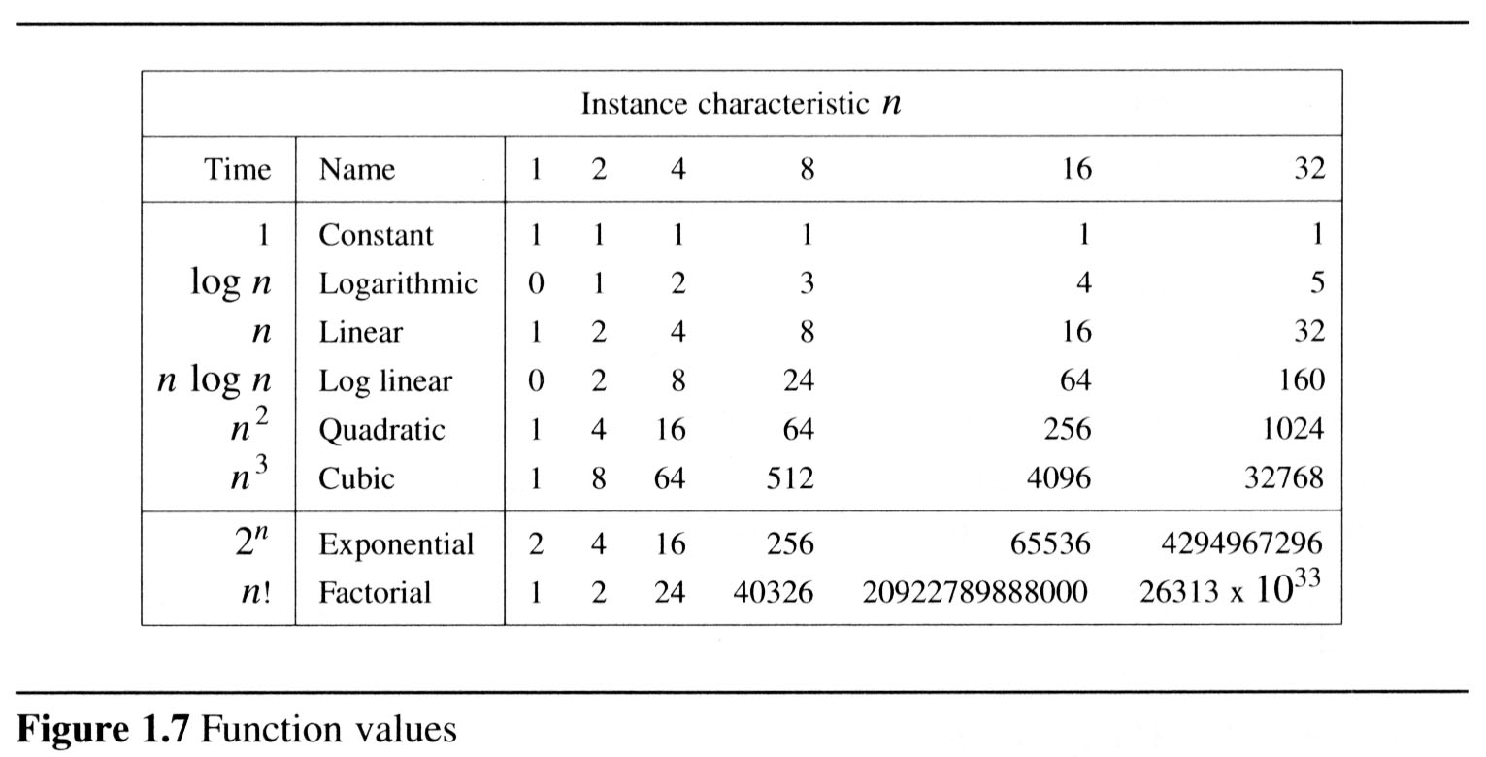

Performance Analysis
1.5.4 Practical complexity
$$n^{n}>n!>2^{n}>n^{3}>n^{2}>nlogn>n$$

Slide 49
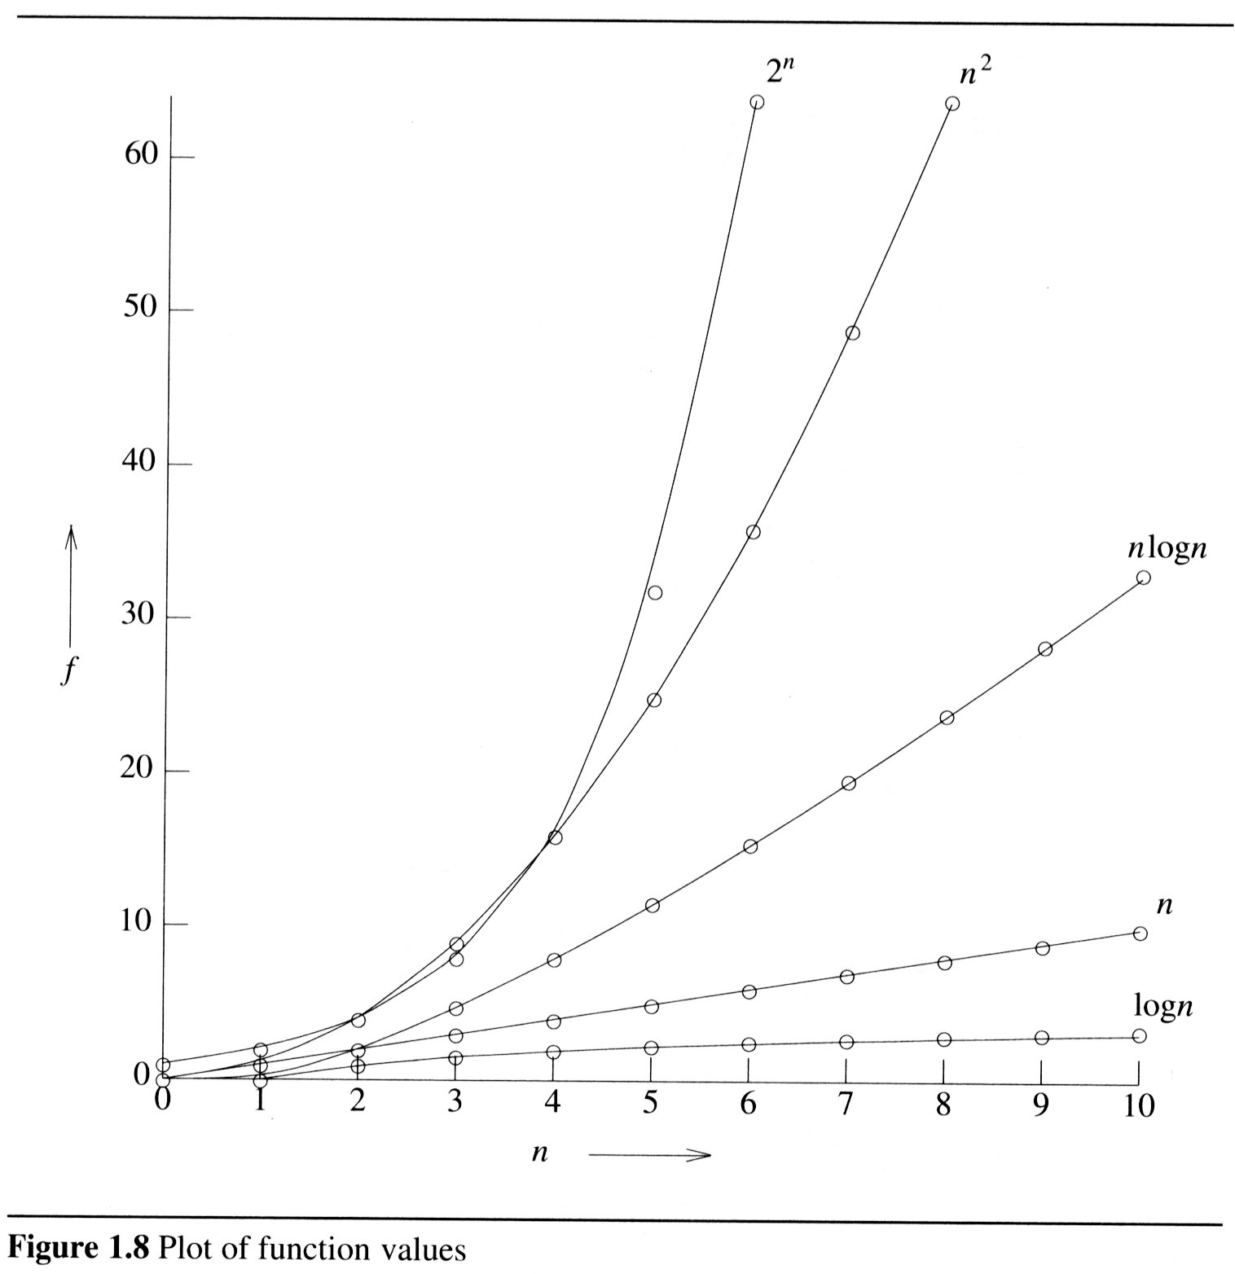
Performance Analysis

Slide 50
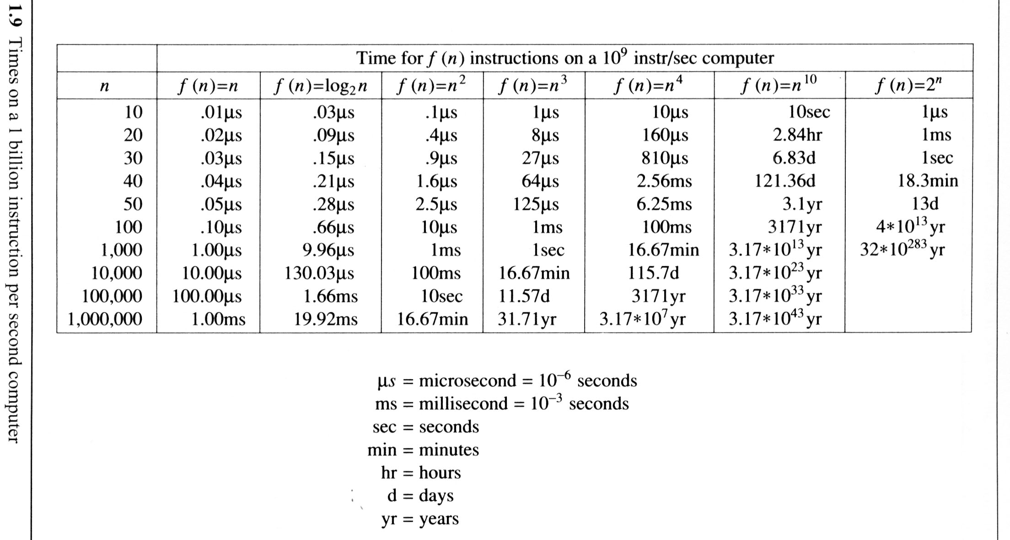
Performance Analysis
The time needed by a 1 billion instructions per second computer to execute a program of complexity f(n) instructions

Slide 51


Example (binary search)
$$T\left(n\right)=T\left(\frac{n}{2}\right)+1, T\left(1\right)=1⇒T\left(n\right)=O(?)$$
$$T\left(n\right)=T\left(\frac{n}{2}\right)+1=T\left(\frac{n}{4}\right)+1+1=T\left(\frac{n}{8}\right)+1+1+1=…=T\left(\frac{n}{n}\right)+\log_{2}n=1+\log_{2}n$$
$$T\left(n\right)=O(logn)$$

Slide 52
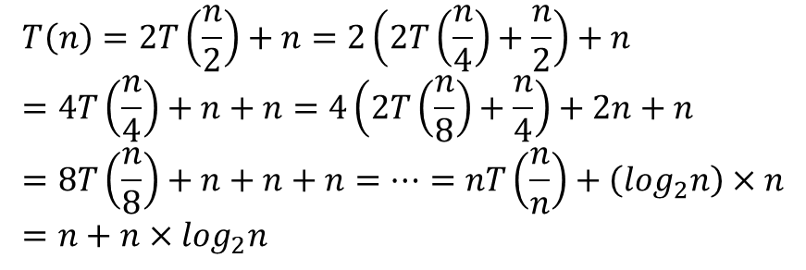


Example (merge sort)
$$T\left(n\right)=2T\left(\frac{n}{2}\right)+n, T\left(1\right)=1⇒T\left(n\right)=O(?)$$
$$T\left(n\right)=2T\left(\frac{n}{2}\right)+n=2\left(2T\left(\frac{n}{4}\right)+\frac{n}{2}\right)+n=4T\left(\frac{n}{4}\right)+n+n=4\left(2T\left(\frac{n}{8}\right)+\frac{n}{4}\right)+2n+n=8T\left(\frac{n}{8}\right)+n+n+n=…=nT\left(\frac{n}{n}\right)+\left(\log_{2}n\right)×n=n+n×\log_{2}n$$
$$T\left(n\right)=O(nlogn)$$

Slide 53
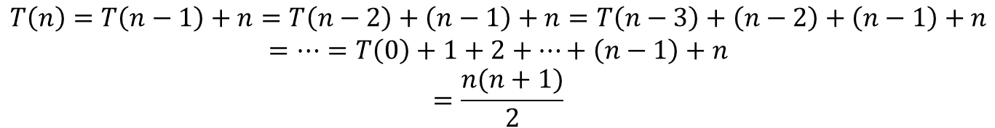

Example
$$T\left(n\right)=T\left(n−1\right)+n, T\left(0\right)=0⇒T\left(n\right)=O(?)$$
$$T\left(n\right)=T\left(n−1\right)+n=T\left(n−2\right)+\left(n−1\right)+n=T\left(n−3\right)+\left(n−2\right)+\left(n−1\right)+n$$
$$=…=T\left(0\right)+1+2+…+\left(n−1\right)+n$$
$$=\frac{n(n+1)}{2}$$
$$T\left(n\right)=O(n^{2})$$

Slide 54
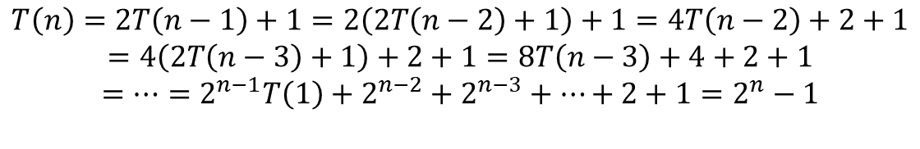

Example
$$T\left(n\right)=2T\left(n−1\right)+1, T\left(1\right)=1⇒T\left(n\right)=O(?)$$
$$T\left(n\right)=2T\left(n−1\right)+1=2\left(2T\left(n−2\right)+1\right)+1=4T\left(n−2\right)+2+1$$
$$=4\left(2T\left(n−3\right)+1\right)+2+1=8T\left(n−3\right)+4+2+1$$
$$=…=2^{n−1}T\left(1\right)+2^{n−2}+2^{n−3}+…+2+1=2^{n}−1$$
$$T\left(n\right)=O(2^{n})$$

Slide 55
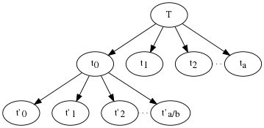
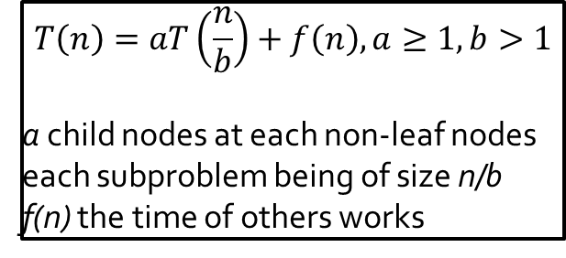
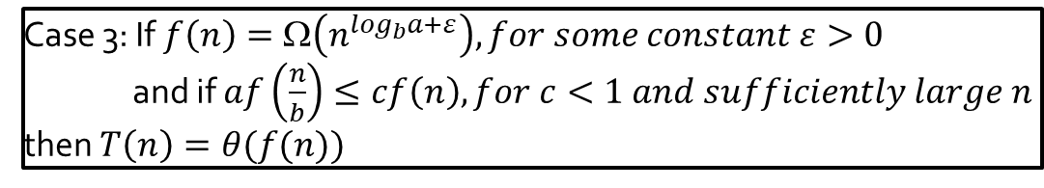
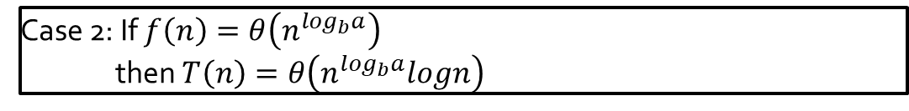
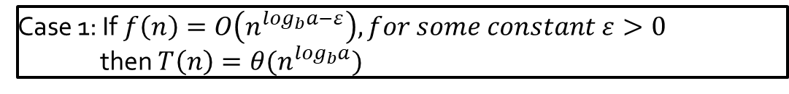
Master theorem
$$T\left(n\right)=aT\left(\frac{n}{b}\right)+f\left(n\right), a≥1,b>1$$
a child nodes at each non-leaf nodes
each subproblem being of size n/b
f(n) the time of others works
Case 1: If $f\left(n\right)=O\left(n^{\log_{b}a−ε}\right), for some constant ε>0$
then $T\left(n\right)=θ(n^{\log_{b}a})$
Case 2: If $f\left(n\right)=θ\left(n^{\log_{b}a}\right)$
then $T\left(n\right)=θ\left(n^{\log_{b}a}logn\right)$
Case 3: If $f\left(n\right)=\text{Ω}\left(n^{\log_{b}a+ε}\right), for some constant ε>0$
and if $af\left(\frac{n}{b}\right)≤cf\left(n\right), for c<1 and sufficiently large n$
then $T\left(n\right)=θ(f(n))$

Slide 56
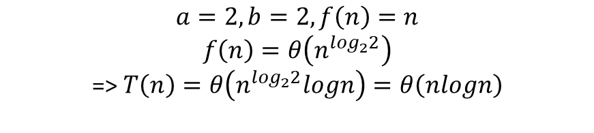

Example (merge sort)
$$T\left(n\right)=2T\left(\frac{n}{2}\right)+n, T\left(1\right)=1⇒T\left(n\right)=θ(?)$$
$$a=2,b=2, f\left(n\right)=n$$
$$f\left(n\right)=θ\left(n^{\log_{2}2}\right)$$
=> $T\left(n\right)=θ\left(n^{\log_{2}2}logn\right)=θ\left(nlogn\right)$
Case 2

Slide 57


Example
$$T\left(n\right)=2T\left(\frac{n}{2}\right)+n^{3}, T\left(1\right)=1⇒T\left(n\right)=θ(?)$$
$$a=2,b=2, f\left(n\right)=n^{3}$$
$$f\left(n\right)=\text{Ω}\left(n^{\log_{2}2+ε}\right)$$
=> $T\left(n\right)=θ(f(n))=θ\left(n^{3}\right)$
Case 3

Slide 58
Performance Measurement

Slide 59
Performance Measurement
Although performance analysis gives us a powerful tool for assessing an algorithm’s space and time complexity, at some point we also must consider how the algorithm executes on our machine.
This consideration moves us from the realm of analysis to that of measurement.

Slide 60
Q&A

